Slide 1
Peer Evaluation Methods
Dr Mary McVey & Dr Avril Edmond
School of Life Sciences, University of Glasgow

Slide 2
Why we include peer evaluation
Benefits for students
Subject specialists
Engaging with the course
Encourage reflective practice
Encourage self-assessment before future submissions
Especially Important in first year
Benefits to staff:
Coping with staff student ratio
Fair allocation of grades in group work
Builds a revision resource
Student feedback:
See value in working with others, and the opportunity to review the work of others.
Notes:
Benefits to students
- Important especially in first year so that students gauge how well they are coping in the course
Benefits to staff
- Large class – we cant do it all ourselves –
Student feedback
Going to tell you about three different systems that we use - how we use each system and a little of the student experience

Slide 3
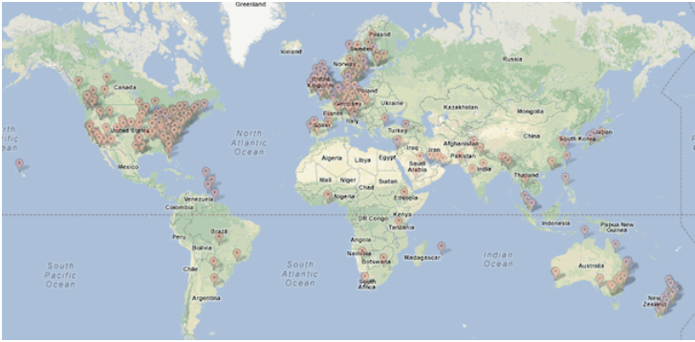
PeerWise: Formative & Summative
Student evaluation of student generated MCQs
Free
Web-based
Wide variety of subject areas
School / FE / HE
Institutional logins
Online Community
Notes:
What it is – everyone can use, maybe you already do
As the map shows it is used in many institutions all across the world.

Slide 4
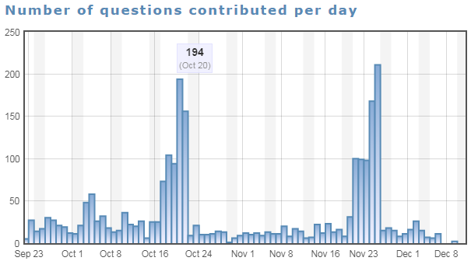
PeerWise: First semester course 2016-17
Worth 5% - students receive MCQ training
4 deadlines
2 submitting questions
2 answering questions
2,407 questions created in total
Notes:
This is our experience
Train students on how to write good MCQs
Summative when worth 5% - students meet the deadlines, lots of Q produced

Slide 5
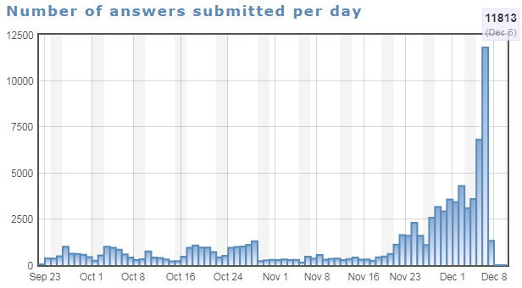
PeerWise: First semester course 2016-17
Used as a revision tool
Notes:
Students use the resources

Slide 6
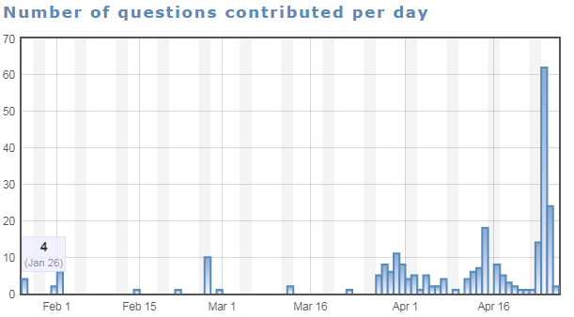
PeerWise: Second semester course 2016-17
Formative
No deadlines
248 questions created in total (1/10th)
Notes:
Same cohort – know the value as they have used it – BUT no credit therefore MOST students don’t engage.

Slide 7
Aropä: Formative & Summative
Student evaluation of student generated writing
Free
Web-based
Wide variety of subject areas
School / FE / HE
Institutional logins
Notes:
Aropa – what it is - 7% UoG students use this

Slide 8
Aropä: Formative & Summative
Student evaluation of student generated writing
Students:
As authors - in submitting an assignment
As markers - evaluating submissions against a set of criteria
Reflecting on feedback from peers
Notes:
Our experience – submission –
Feedback from 2 students does not always agree.
Students then have to use their judgement - teaching them self evaluation

Slide 9
Our Experience
Surprisingly polite to one another
Not keen on questions that are too easy
Several comments about spelling mistakes
PeerWise - Self- reflection is evident
Many suggestions for improvement
Feedback relates to marking scheme
Statements (3 to 266 words)
Positive comments
Referencing – with examples
Notes:
For both systems - polite and
students write lots of comments seen for both systems ; Aropa 300 words – 3 to 266 words in review
Spelling mistakes - ? Aropa
Self reflection – include example
Suggestions for improvement – MCQ and Aropa

Slide 10
Peer evaluation of group work: Summative
Student evaluation of student contribution to group work
Bespoke – online system developed by local IT services
Group presentations graded by staff
Individual student scores are adjusted by peer scores.
4 criteria decided by students at the beginning of project
Peer scores given for all group members
Statistical analysis to look for unfair marking
Individual student grades adjusted and published
Students would like to provide peer feedback as comments
Notes:
Lastly – we get students to peer evaluate their peers contribution to group work
Class of 700 about 10 query their individual grade – we have 4 points of reference to justify that
However--

Slide 11
Summary
PeerWise: Formative & Summative
Student evaluation of student generated MCQ’s
Aropä: Formative & Summative
Student evaluation of student generated writing
Peer evaluation of group work: Summative
Student evaluation of student contribution to group work

Slide 12
Group Projects: Peer Grading
Each group agrees 4 marking criteria that they will be scoring each others contribution to the project on.
Students score their group members on these criteria.
Moderation picks up on any unusual scoring patterns
This gets combined with the staff score to generate each students individual grade for the assessment.
$$Individual Score=\left(\frac{Individual Mean Peer Score}{Highest Mean Peer Score in group}\right) x Staff score$$

