Slide 1
Inclusivity as the focus of design
Dave Foord
@davefoord
of 20
Notes:
Dave Foord is a freelance trainer, consultant and materials developer, and this presentation is about the materials development side of things, and how he creates things that are naturally reasonably inclusive, rather than create things and then adapt them later.

Slide 2

of 20
Notes:
This presentation is not saying that what Dave does is right or wrong, it is just saying what he does.

Slide 3

of 20
Notes:
Alistair McNaught coined the phrase – ‘The shiny Ladders Award’ – which is where organisations create content that is inaccessible (eg has barriers or walls to access it), and then go to great lengths creating systems to allow students to climb (ladders) over this barrier. Dave’s focus is to either have no barrier or at least smaller ones initially.

Slide 4
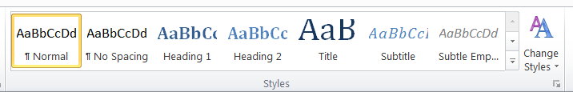
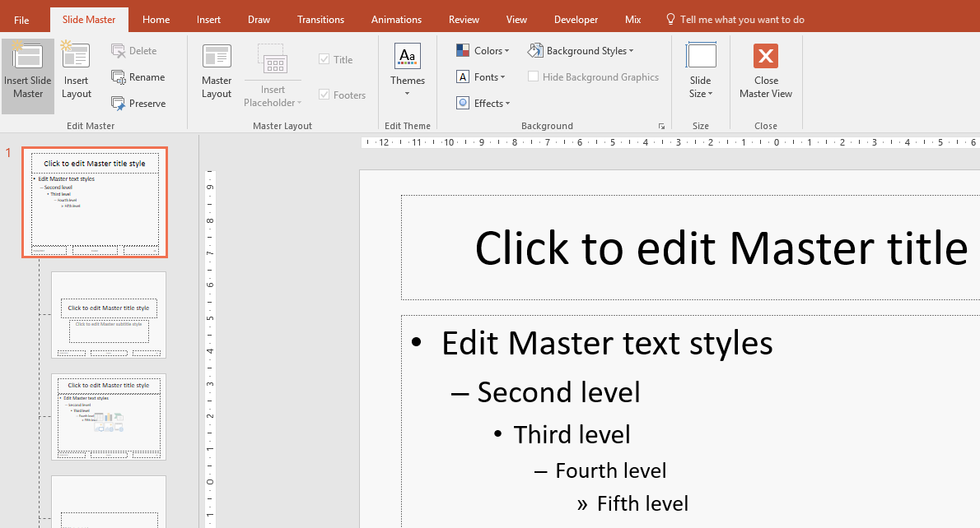
of 20
Notes:
Dave has used good accessible practice for many years, starting with using the Styles in Word, and the Master slide in PowerPoint.

Slide 5
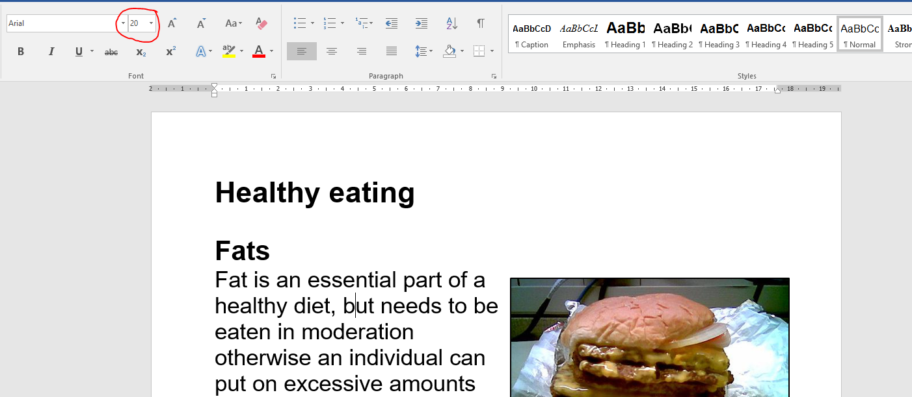
of 20
Notes:
Which was very useful when a student with a visual impairment was on the course, as very quick and easy for Dave to make the adjustments for that student.

Slide 6
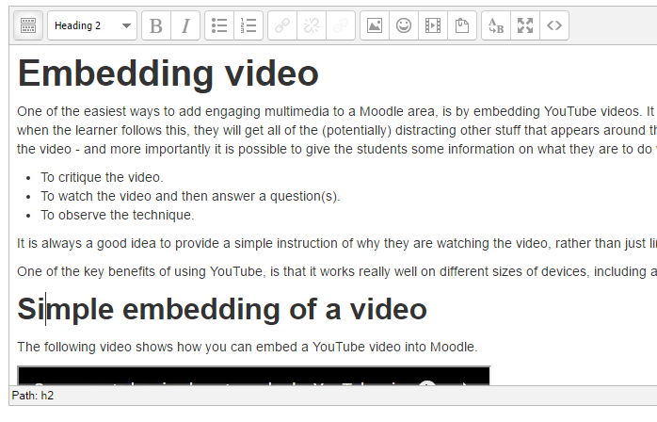
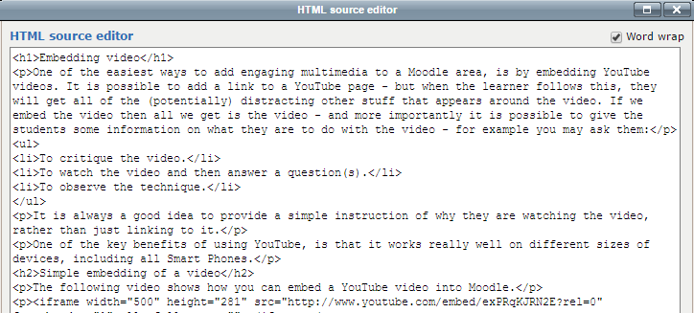
of 20
Notes:
And this behaviour goes into the creation of online content, e.g. the correct use of headings, paragraph text, etc. to create clean html.

Slide 7
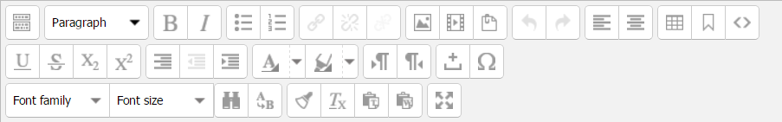

of 20
Notes:
Within VLEs like Moodle there are certain editing features that one should never use, e.g. change the font family, font size, font colour, font background etc. So Dave removes these buttons from the editor.

Slide 8
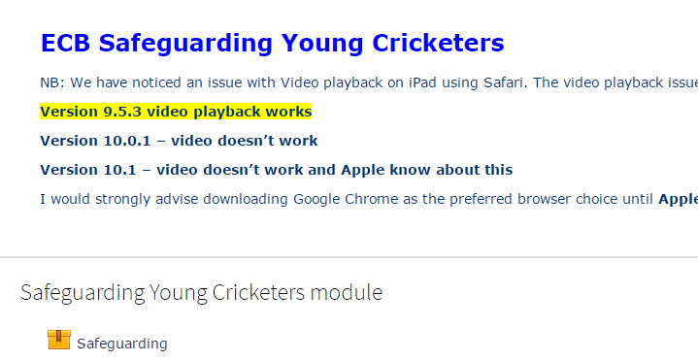
of 20
Notes:
Dave does not like SCORM packages, as although they main claim to meet technical accessibility criteria, just opening them up is an accessibility barrier, and in general using SCORMs reduces accessibility.

Slide 9
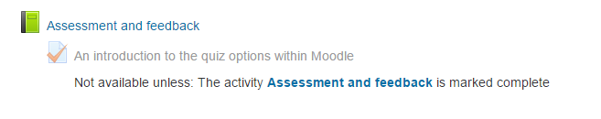
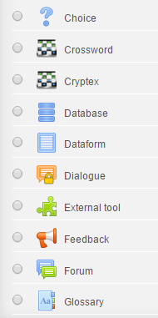
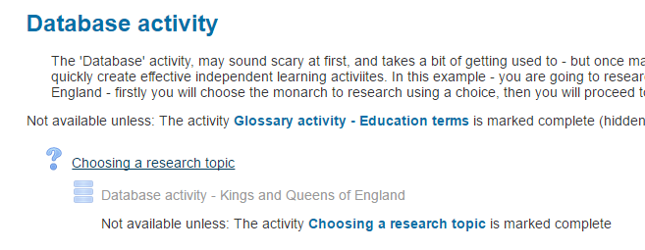
of 20
Notes:
So instead, Dave uses the native tools within the VLE. In Moodle this will be things like the Book or Lesson tool, and then activities such as the Quiz, Choice, Database, Forum, Journal, Dialogue etc.

Slide 10
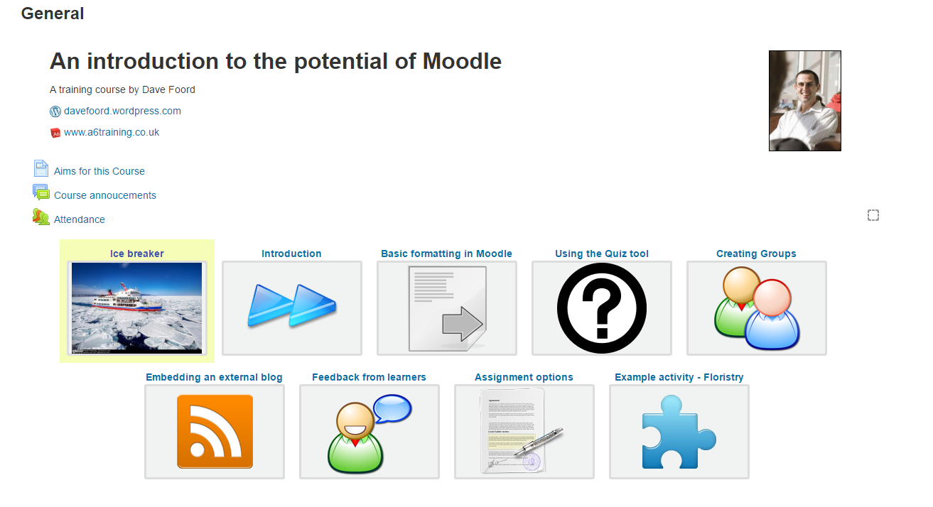
of 20
Notes:
Here is an example of a course that Dave runs, and at first there is a lot of content here, which in itself can be a barrier to some.

Slide 11
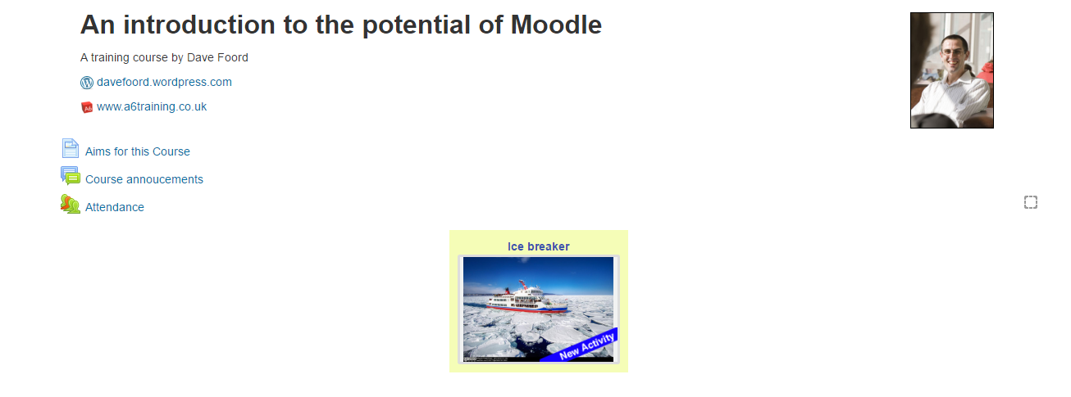
of 20
Notes:
So what Dave does, is when the user first comes in, they only see one section, when they have completed certain activities in that section, they see more sections etc.

Slide 12
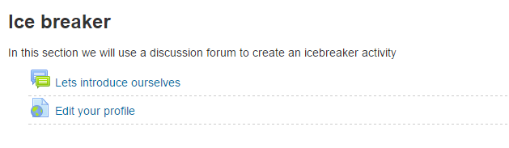
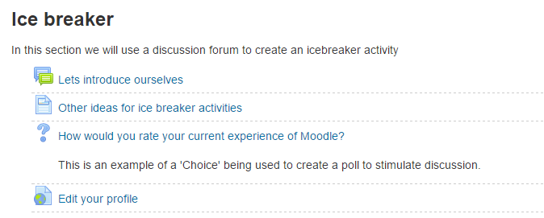
of 20
Notes:
And within the sections, rather than having a long list of ‘stuff’ – the learner gets a small number of options, which increases as they progress through the course.

Slide 13
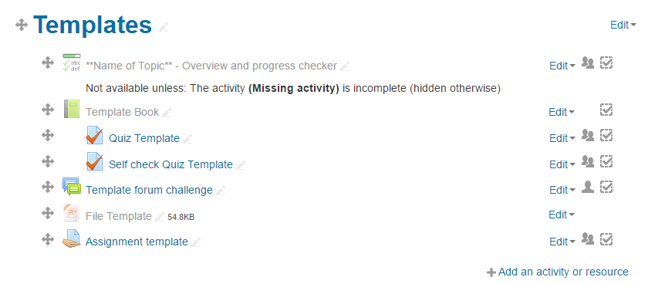
of 20
Notes:
Dave uses templates a lot, these are simply blank activities at the bottom of the course, which he duplicates, moves into the correct position, renames and then populates. This firstly saves time, but also makes the activities more consistent in their behaviour, which in turn is an accessibility benefit.

Slide 14
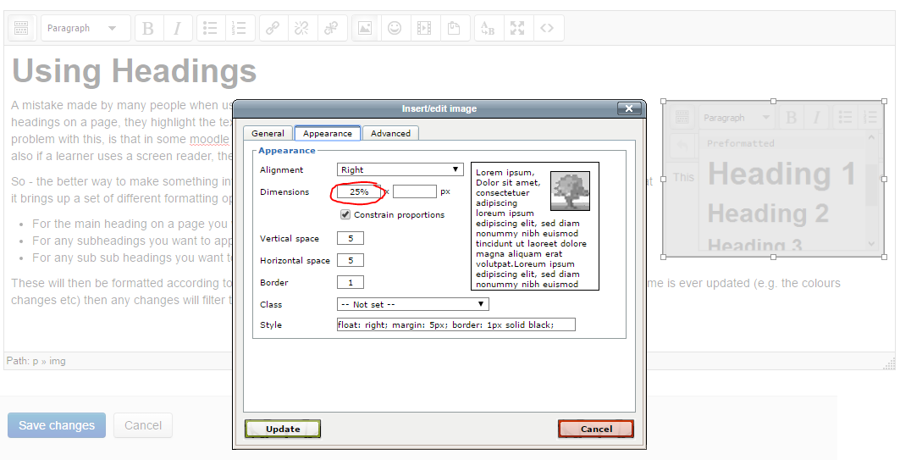
of 20
Notes:
If using an image for decoration, Dave will often set the width size to a percentage, so the image resizes proportionally to the size of the screen or resolution.

Slide 15
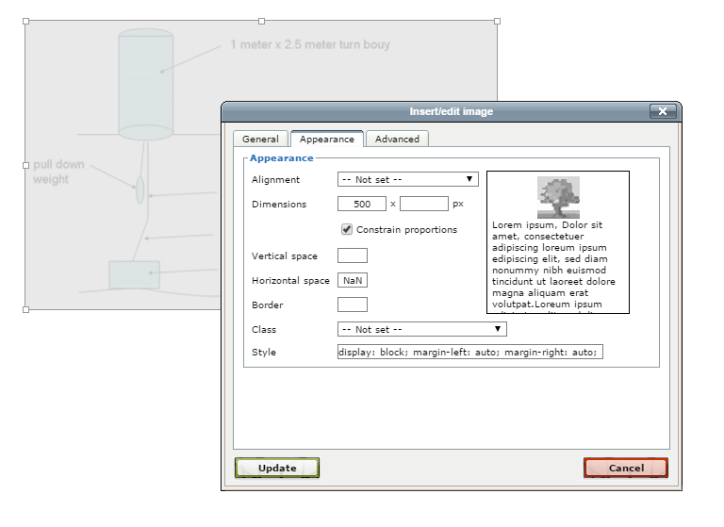
of 20
Notes:
However if the image is descriptive, or contains labels etc. having this shrinking when viewed on a small screen, makes it hard to access – so in that case the image is set to an absolute width, for which Dave has a rule of thumb of never going wider than 500 pixels.

Slide 16
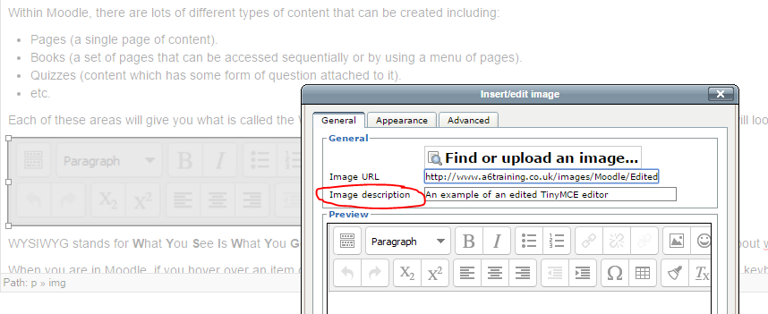
of 20
Notes:
And of course, all images will have an Image Description, (Alt text) added.

Slide 17
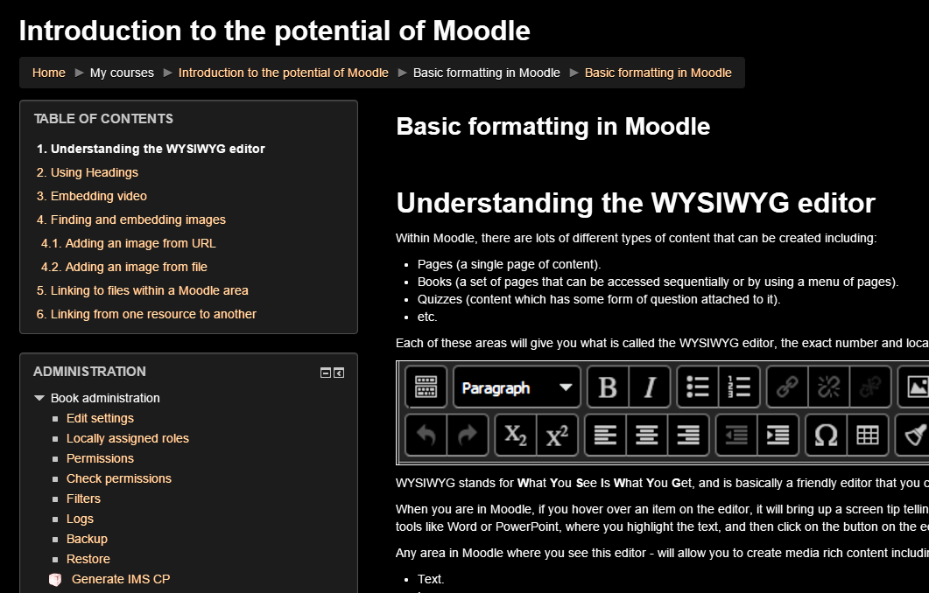
of 20
Notes:
Dave is constantly testing his work – if using Chrome, he uses a plugin that inverts the colours.

Slide 18
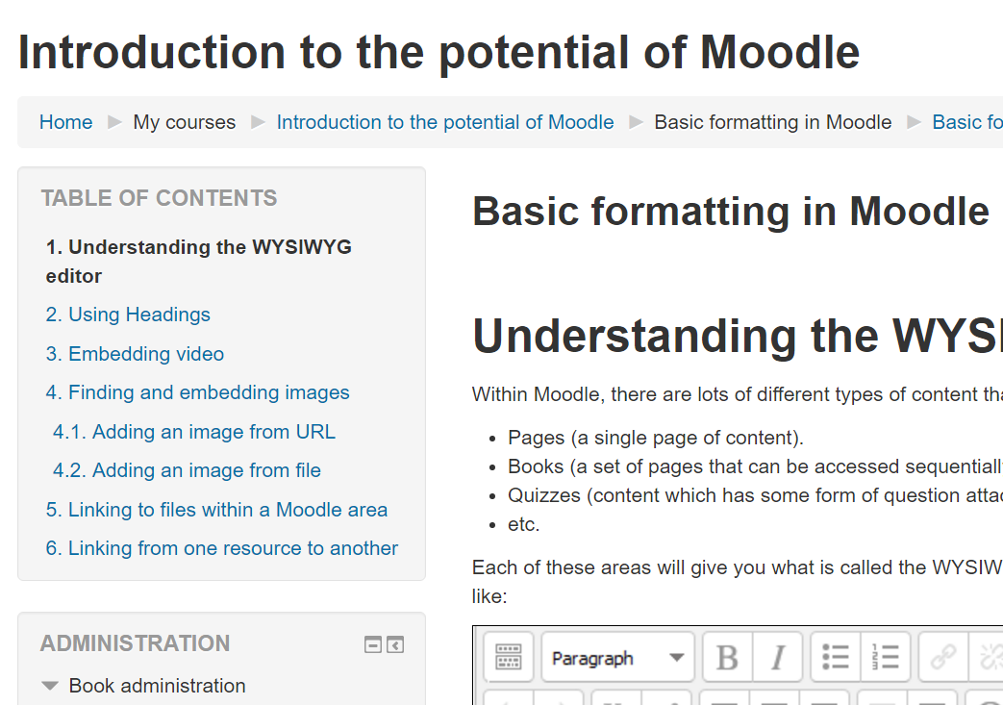
of 20
Notes:
Another simple test is to use ctrl + or ctrl – to increase or decrease the zoom – and see if it still works at the extremes.

Slide 19
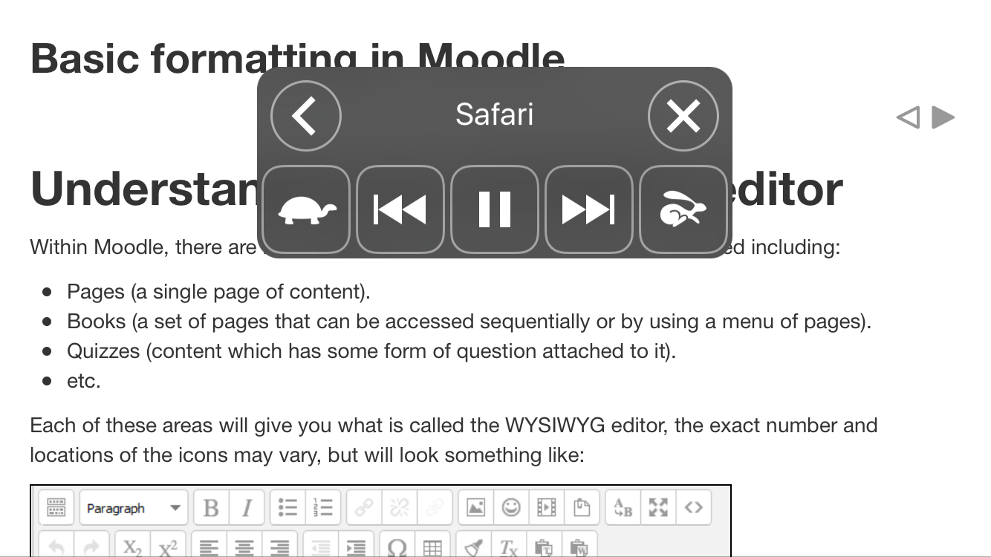
of 20
Notes:
And testing on Mobile devices. If using an iphone another useful test would be to turn on the text to speech facility and see if the content/layout still makes sense.

Slide 20
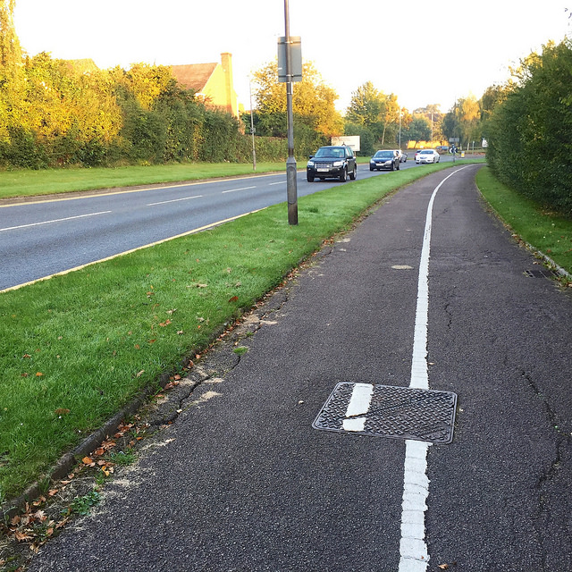
Image Source: https://www.flickr.com/photos/86569608@N00/21493643023/
of 20
Notes:
Dave has obsessive behaviours when it comes to this sort of work, which some find frustrating, but is a really useful attribute when creating accessible content.

Slide 21
Inclusivity as the focus of design
Dave Foord
@davefoord
https://davefoord.wordpress.com/

