Slide 1
Learning analytics and ethics
EMLT Meeting
University of Northampton
14th Dec 2017
Niall Sclater @sclater

Slide 2
From your perspective, what’s the biggest ethical challenge with learning analytics?

Slide 3
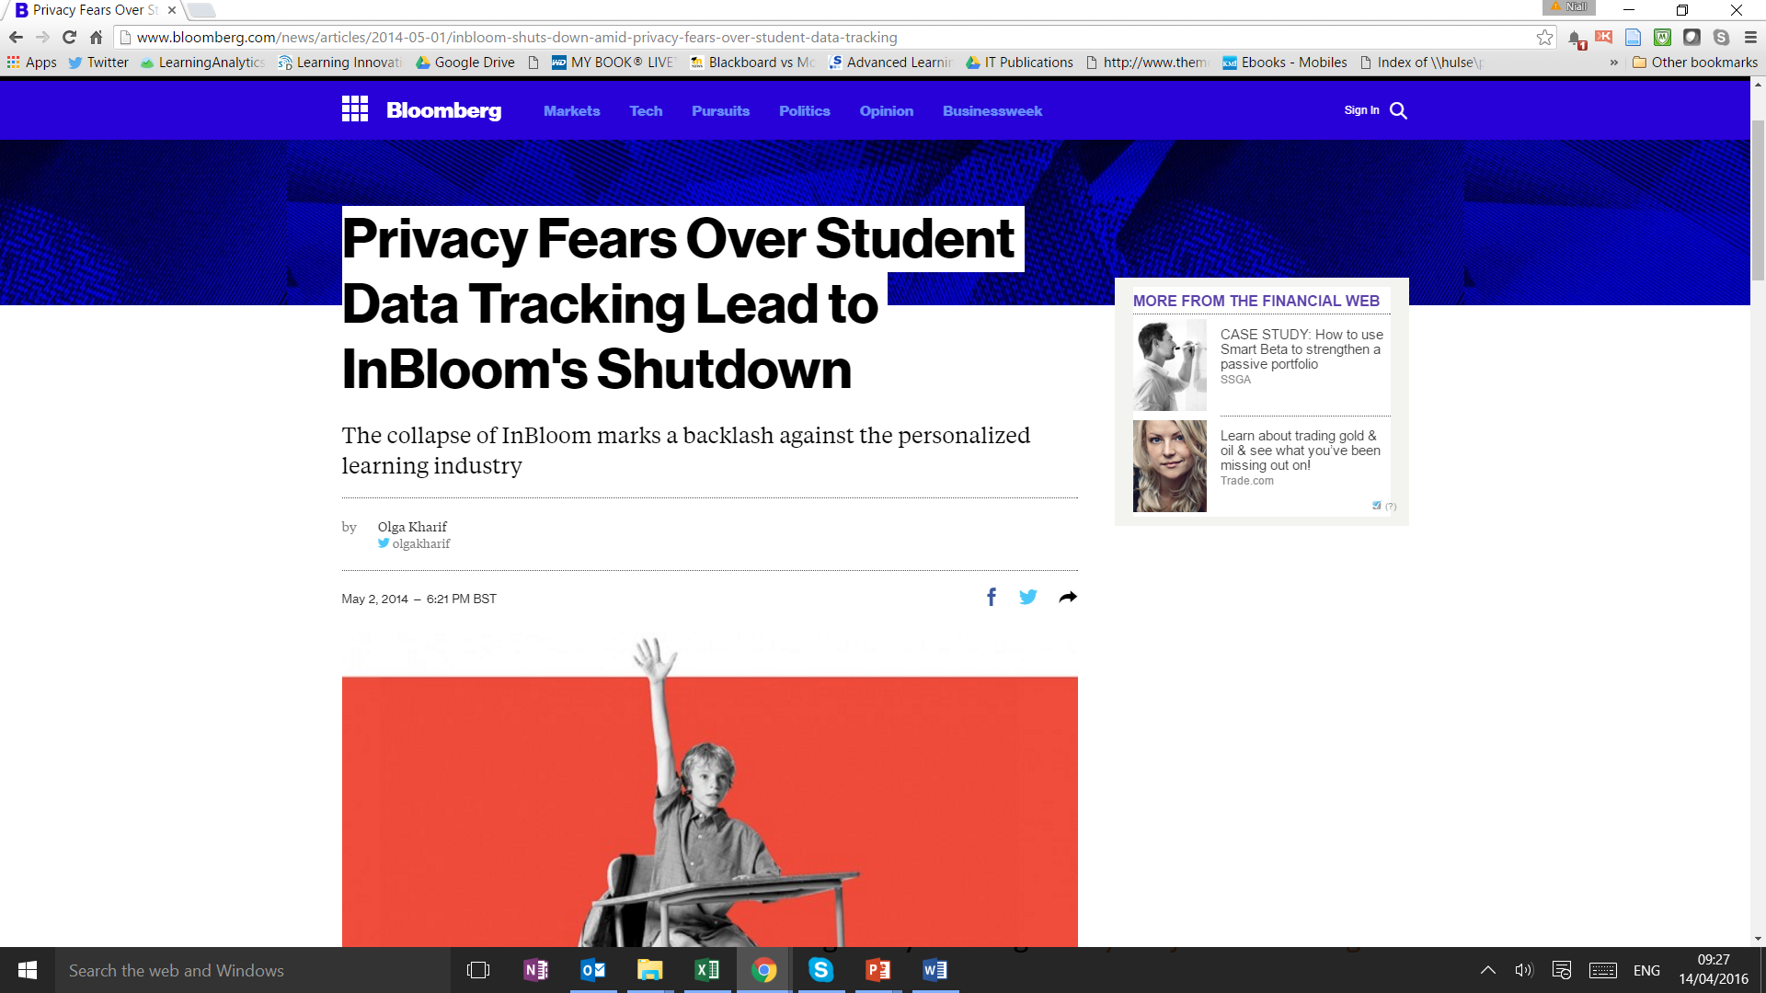

Slide 4
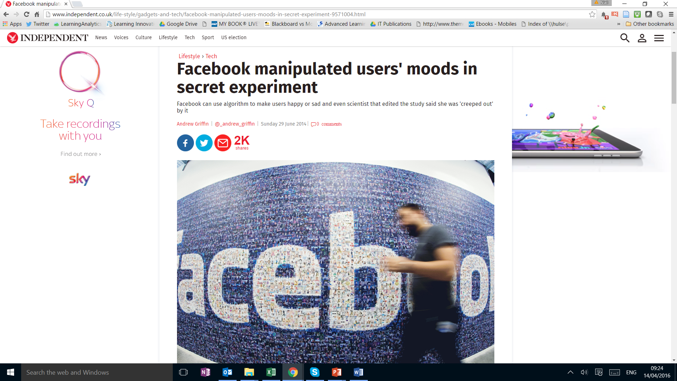

Slide 5
Education is different

Slide 6
The problem of flawed or inadequate data

Slide 7
Predictions are not always valid or correct

Slide 8
Rio Salado College, Arizona

Slide 9
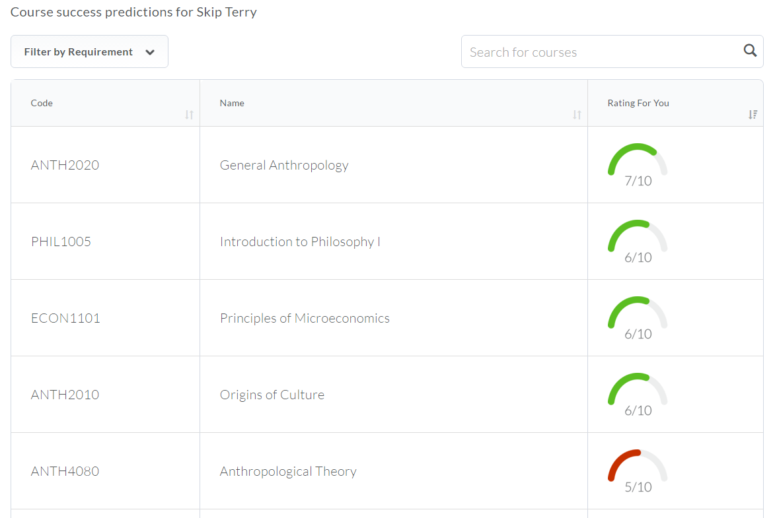
Course recommendation
Brightspace Degree Compass

Slide 10
Adaptive learning
LeaP Screenshot: D2L Corporation

Slide 11
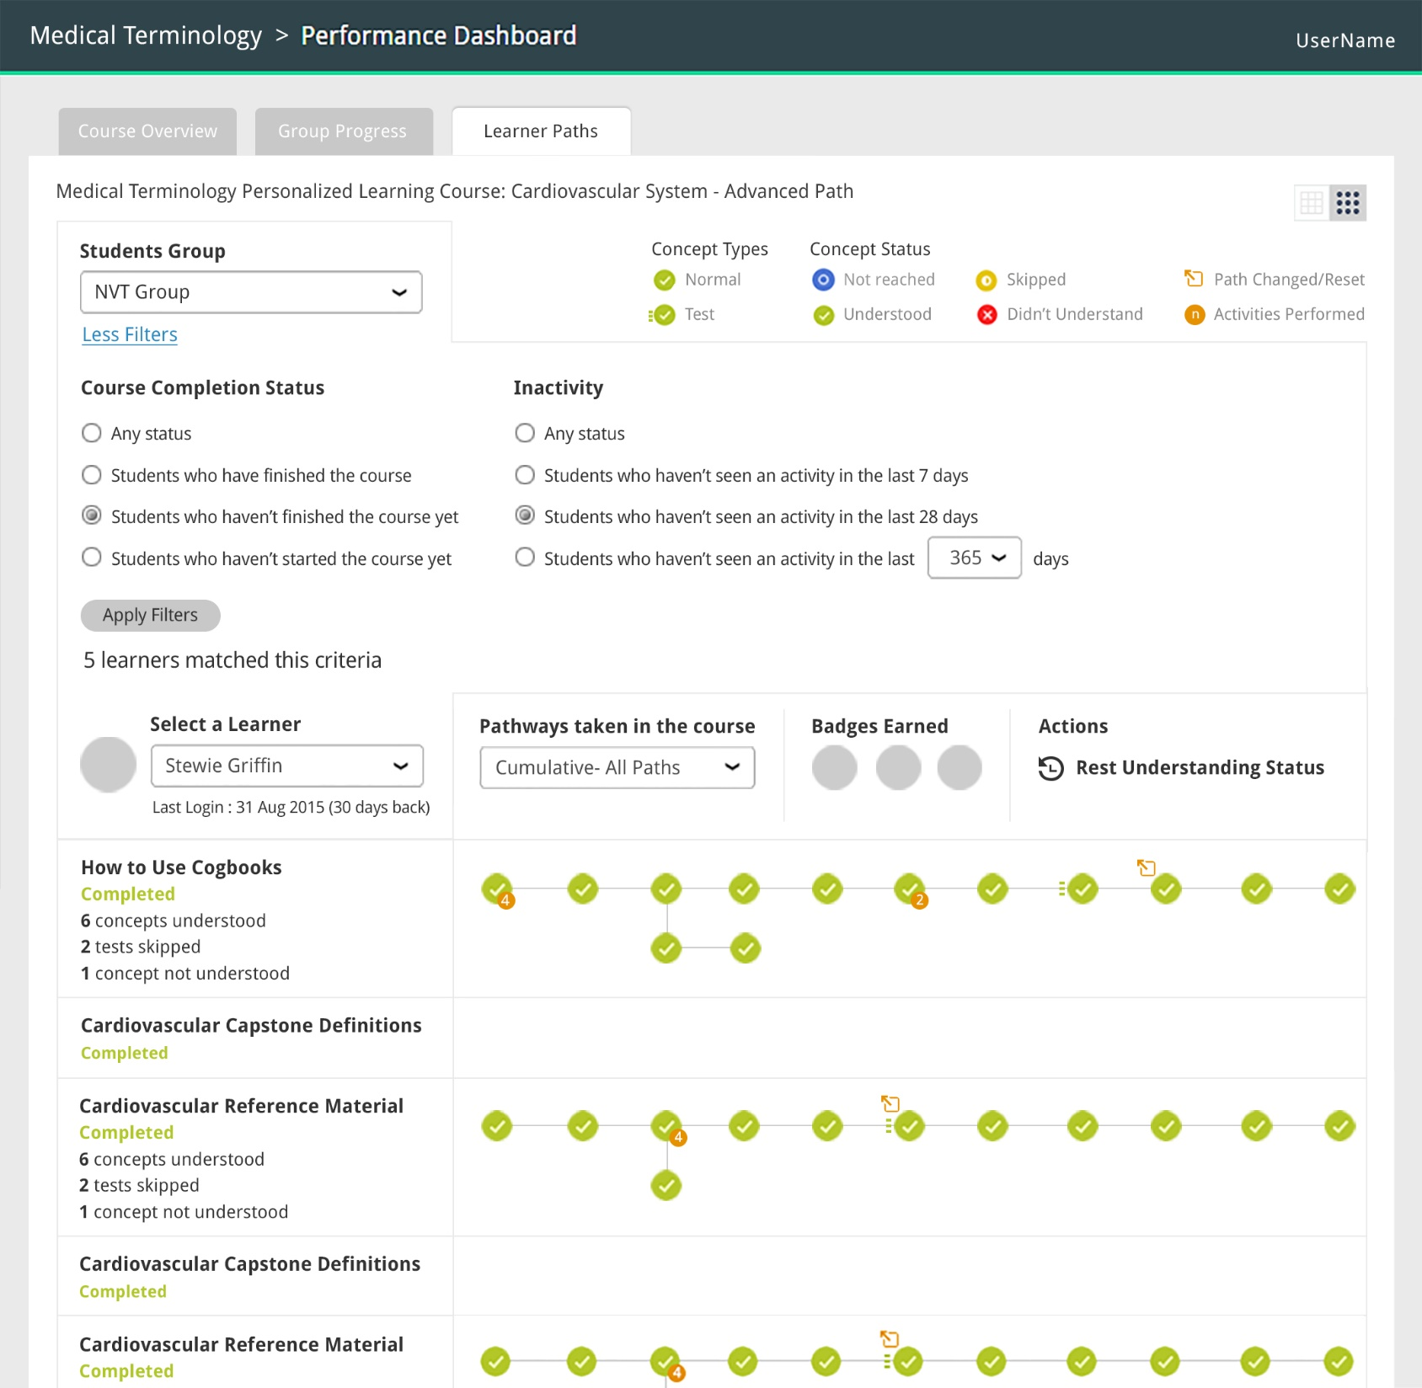

Slide 12
Loss of autonomy
Could student autonomy in decision making be undermined by predictive analytics?

Slide 13
Potential demotivation of students

Slide 14
Negative impacts of continual monitoring

Slide 15
Manipulation of the analytics by students

Slide 16
Prejudicial categorisation and treatment of students
Could analytics reinforce discriminatory attitudes and actions?

Slide 17
Reduction of the individual to a metric

Slide 18
Triage

Slide 19
Should students be asked for their consent to collect data about them for use in learning analytics?

Slide 20
External access to student data

Slide 21
Giving students access to their data

Slide 22
Should interventions always be mediated by a human?

Slide 23
Available from Effective learning analytics blog: analytics.jiscinvolve.org

Slide 24
Group | Name | Question | Main type | Importance | Responsibility
2 Consent | Adverse impact of opting out on individual | If a student is allowed to opt out of data collection and analysis could this have a negative impact on their academic progress? | Ethical | 1 | Analytics Committee
7 Action | Conflict with study goals | What should a student do if the suggestions are in conflict with their study goals? | Ethical | 3 | Student
8 Adverse impact | Oversimplification | How can institutions avoid overly simplistic metrics and decision making which ignore personal circumstances? | Ethical | 1 | Educational researcher
86 issues in 9 groups

Slide 25
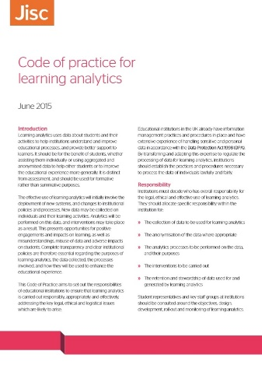
Group | Name | Question | Main type | Importance | Responsibility
2 Consent | Adverse impact of opting out on individual | If a student is allowed to opt out of data collection and analysis could this have a negative impact on their academic progress? | Ethical | 1 | Analytics Committee
7 Action | Conflict with study goals | What should a student do if the suggestions are in conflict with their study goals? | Ethical | 3 | Student
8 Adverse impact | Oversimplification | How can institutions avoid overly simplistic metrics and decision making which ignore personal circumstances? | Ethical | 1 | Educational researcher

Slide 26
jisc.ac.uk/guides/code-of-practice-for-learning-analytics

Slide 27
The obligation of knowing
If the analytics tell us that a student is likely to drop out do we have a responsibility to do something about it?

Slide 28
@sclater
sclater.com/blog
analytics.jiscinvolve.org

